Slide 1
Teaching international classes
The Escape Game
Clermont Auvergne University
Learn'in Auvergne and IPPA Teams
November 2019

Slide 2
Words of caution : SPOILER
The following slides present the solutions to the 6 riddles of the escape game
Do not look at them if you want to enjoy the game !
This game is inspired by the French Escape Game LearningScape, created by the GameLab of CRI & SAPIENS-USPC https://sapiens-uspc.com/learningscape-2/
Creative Commons BY-NC-SA 3.0 FR
A special thank you to their pedagogical and gamer team !

Slide 3
Rules of the game
Leave all your stuff in this room
You don’t need to disassemble anything
Do not turn on the lights
Nothing is hidden around the computers
You will have 30 minutes to solve Camilla’s problems → access to her brain through the computer
You can wake up Camilla 3 times if you need some help
Sometimes, Camilla talks in her sleep….. Listen to her ☺

Slide 4
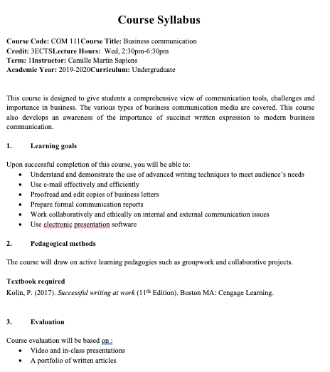
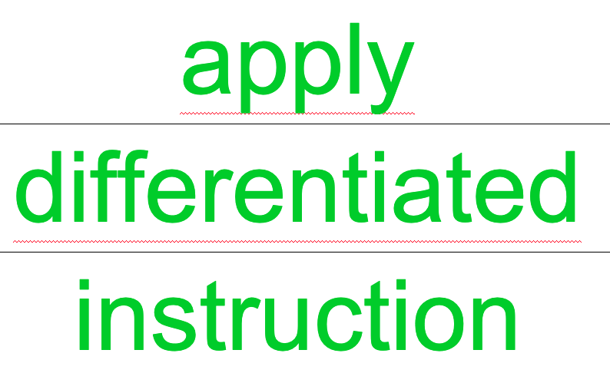
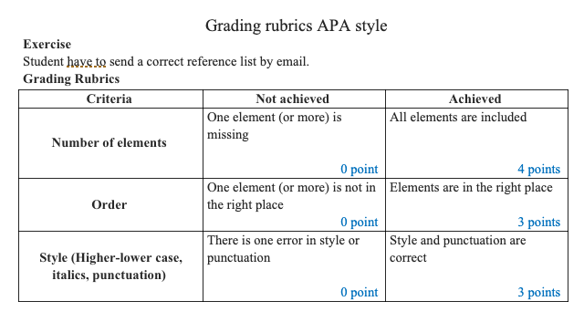
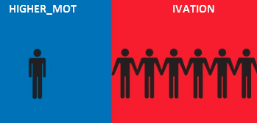
The 6 riddles
Which course elements should be aligned in my syllabus ?
Learning goals → Pedagogical methods → Evaluation
What should I change to accomodate culturally diverse students ?
What happens if I take into account the diverse learning preferences of my students ?
How to wake up my students ?
3 balls : Project-based group work, Flipped classroom, interactivity
Here is what we get when we move tables….
Collaboration
I still have to grade some exercises
Apply the grading rubrics

Slide 5
Wrap up of your experience : What did you like ?
Among the 6 themes presented in the escape game :
Pedagogical alignment
Differentiated instruction
Accomodating learning preferences → higher motivation
Active learning
Collaboration
Grading Rubrics
Which one do you use in your class ?
Advantages and challenges ?
In your experience, what is working with international students ?
Notes:
Dans la salle : one adjective to tell us if you liked.

Slide 6
References
The escape game « Learningscape » (in French) : SAPIENS, Université Sorbonne Paris Cité, https://sapiens-uspc.com/learningscape-2/
2nd version of the kit Learningscape (in French) : https://sapiens-uspc.com/learningscape-2/
Banks, J. A. (2016). Cultural diversity and education (6th ed.). New York, NY: Routledge.
Gay, G. (2010). Culturally responsive teaching: Theory, research, and practice (2nd ed.). New York, NY: Teachers College Press.
Liu, Y. (2015). Orient/Occident. Mode d’emploi (Taschen).
McKeachie, W., & Svinicki, M. (2014). McKeachie’s Teaching Tips: Strategies, Research, and Theory for College and University Teacher. Wadsworth: Cengage Learning

Slide 7
Thank you !
Contacts : Learninauvergne.cap2025@uca.fr and ippa.df@uca.fr

