Slide 1
La POllution des Nuages contribue-t-elle à la COntamination des Sols ? PONCOS
Angelica Bianco, Pascale Besse-Hoggan
The main purpose of this project is to perform a targeted analysis of a wide spectrum of pesticides, PCBs and PAHs in cloud samples collected at puy de Dôme and soil leachate samples collected at Opme.
Project « pot de fleurs sans fleur »
Angelica Bianco, projet PONCOS, journée FRE 2024

Slide 2
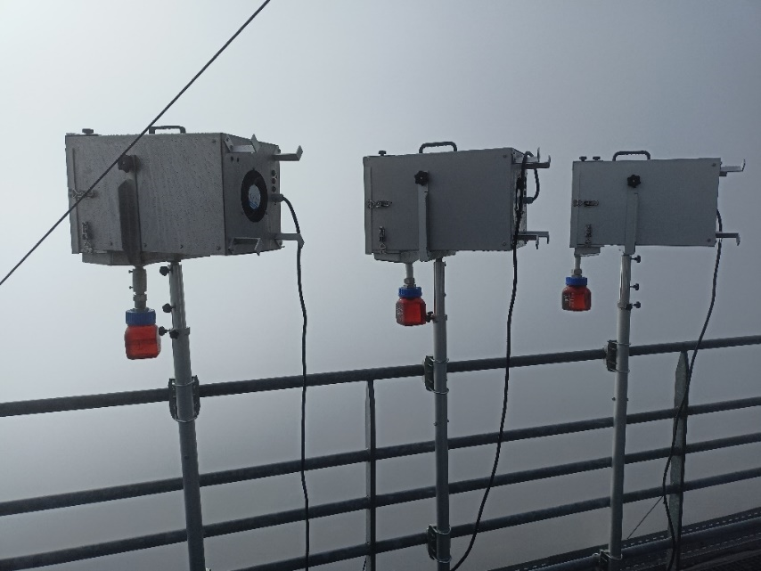
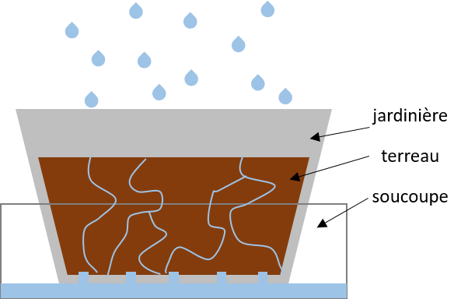
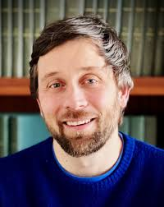
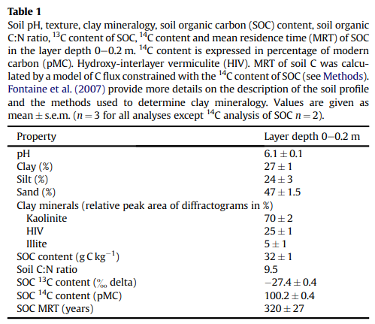
Cloud sampling
Soil leachate
Commentaire FRE:
Projet original et pertinent.
Des questions persistent sur la validité du dispositif expérimental. Nous vous conseillons de vous rapprocher d'experts des sols (p ex à l'UREP) pour valider.
Fontaine et al. (2011)
L. Deguillaume
Long experience in cloud water studies
Sampling at puy > 20y
Angelica Bianco, projet PONCOS, journée FRE 2024
1

Slide 3
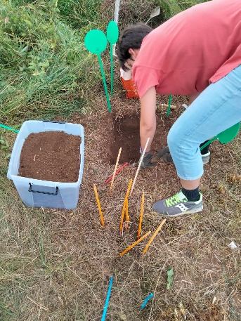
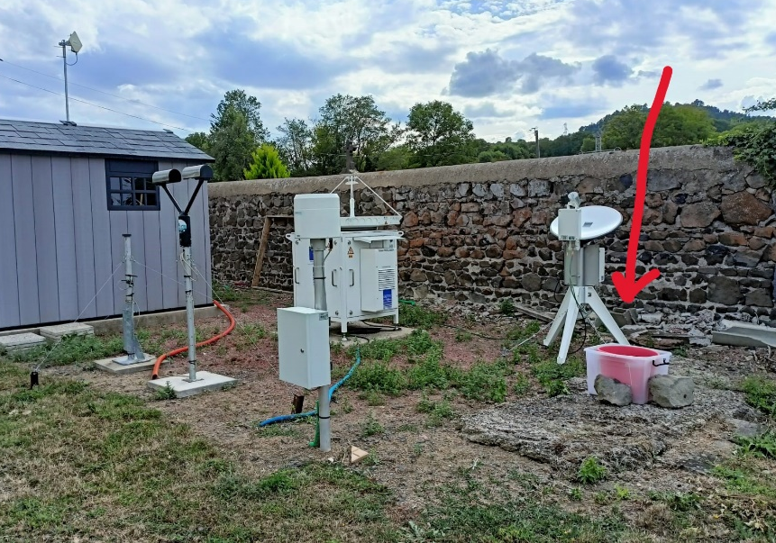
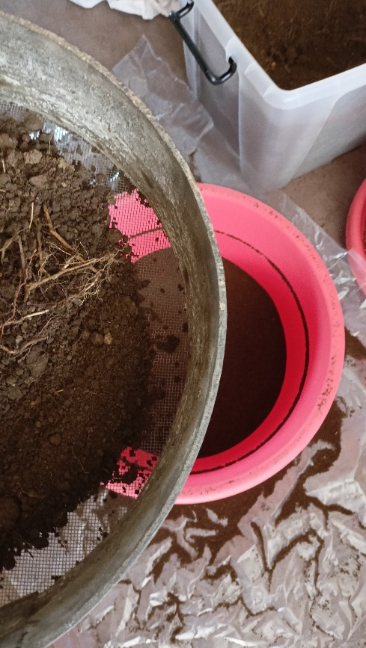
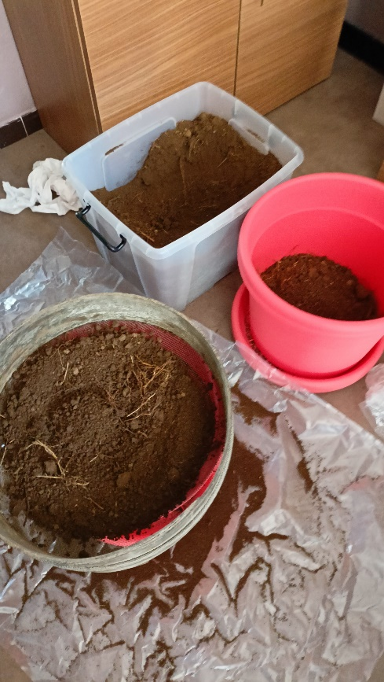
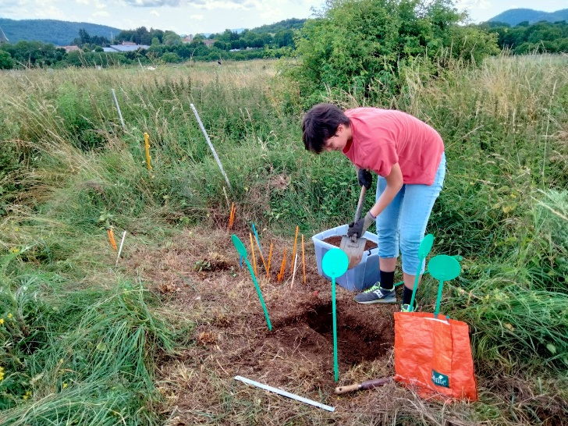
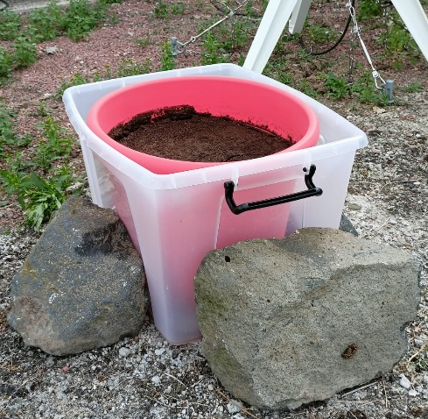
Julien Pottier → Gaël Alvarez → Frédérique Louault
Sampling of 40 L of soil July 2023
Pot de fleurs sans fleurs installed in September 2023
sifted on sieve 2 mm metal mesh
Angelica Bianco, projet PONCOS, journée FRE 2024
2

Slide 4
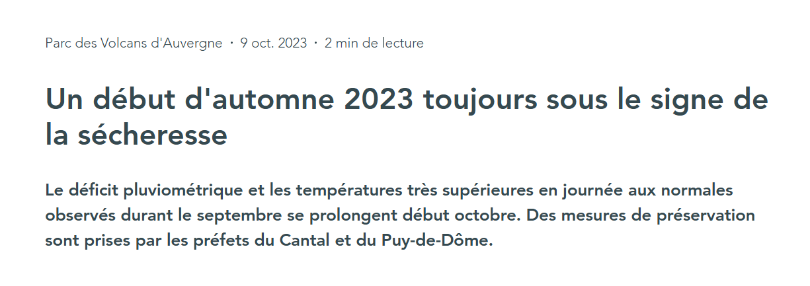
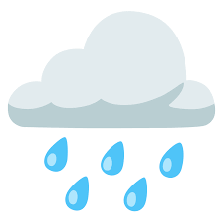
1st problem
Rain events were « light » and the soil was just wet → no leachate was collected
2nd problem
Results
2 cloud samples collected
1 blank sample of leachate
2 samples of leachate, but not corresponding to clouds
We decided to focus our attention on the characterization of pesticides in cloud water
Angelica Bianco, projet PONCOS, journée FRE 2024
3

Slide 5
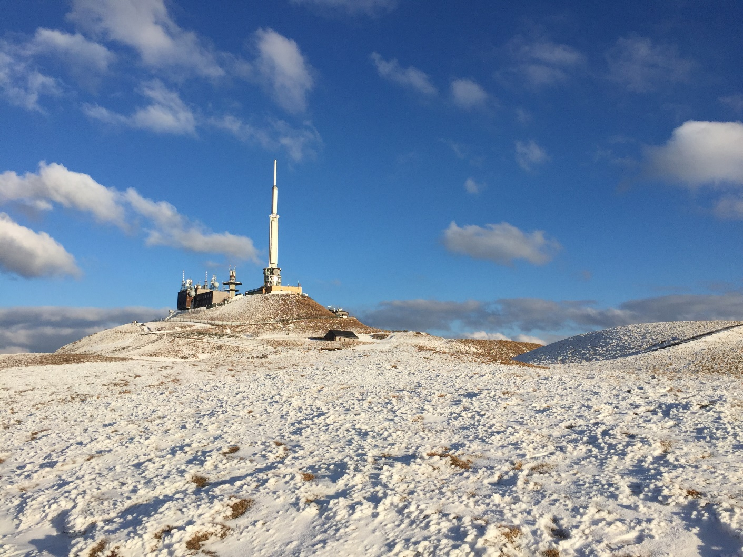
This work is supported by FRE and CNRS-INSU
The authors acknowledge the financial support from the Observatoire de Physique du Globe de Clermont-Ferrand (OPGC)
Thanks for your attention!
Angelica Bianco, projet PONCOS, journée FRE 2024
10

